Slide 1

Market price Prediction Using Machine Learning

Slide 2
Introduction
In the realm of market analysis and forecasting, understanding the intricate patterns within time series data is paramount for informed decision-making. With the advent of machine learning techniques, it’s now possible to delve deeper into historical market data to predict future trends accurately. In this context, we have at our disposal a dataset containing monthly market data spanning multiple years, encompassing various regions, commodities, and pricing information.

Slide 3
objectives
The primary objective of this project is to develop a robust time series machine learning model capable of accurately forecasting market trends based on historical data. By leveraging advanced algorithms, we aim to predict the quantity and prices of commodities for future months, empowering stakeholders to make proactive decisions regarding production, procurement, pricing strategies, and resource allocation.

Slide 4
Dataset’s Attributes
market: The market or commodity under consideration.
month: The month for which the data is recorded.
year: The year corresponding to the recorded data.
quantity: The quantity of the commodity traded or available.
priceMin: The minimum price of the commodity during the month.
priceMax: The maximum price of the commodity during the month.
priceMod: The mode or most frequently occurring price of the commodity during the month.
state: The state or region where the market is located.
city: The city where the market is situated.
date: The specific date of the recorded data.

Slide 5
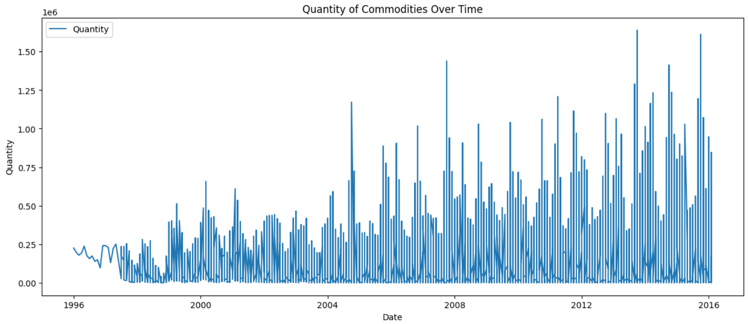
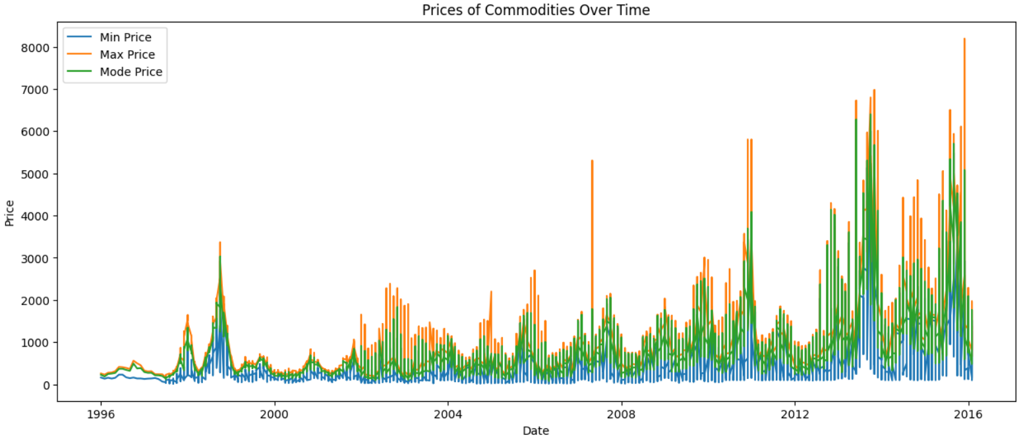
EDA

Slide 6
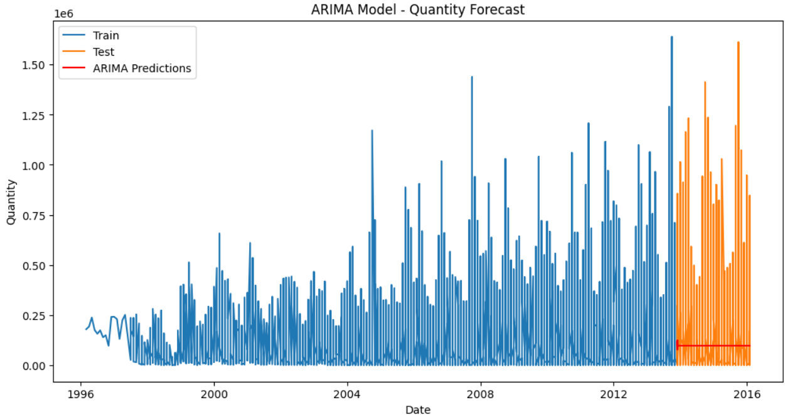
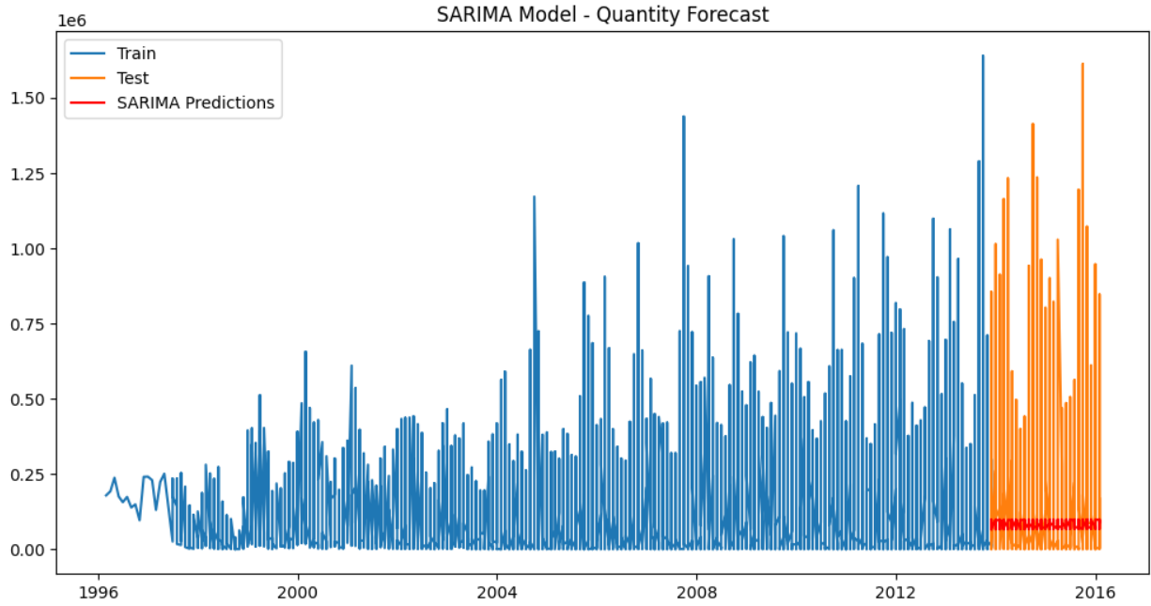
Models used
ARIMA
SARIMA

Slide 7
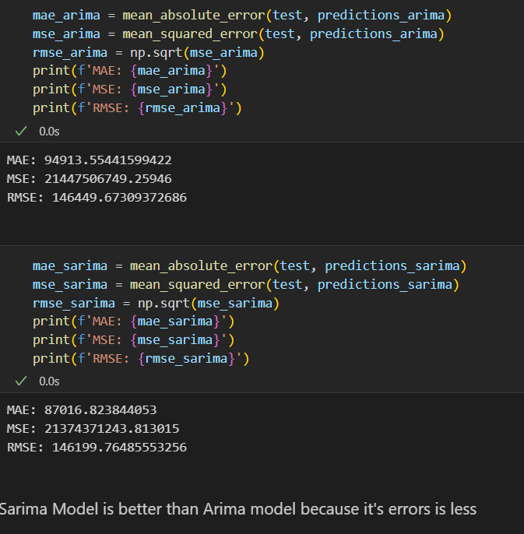
Results

Slide 8
Thank you

